Slide 1
Make OVS DPDK a First-class Citizen in Openstack
Yi Yang @ Inspur Cloud

Slide 2
Agenda
OVS DPDK Performance Issues
Solutions to OVS DPDK Performance Issues
Implementation Status of Solutions
Implementation Details of Solutions
Performance Comparison
Future Work
Demonstration

Slide 3
OVS DPDK Performance Issues
Bad VM-to-VM performance
Bad VM-to-VM L3 routing performance
Bad VM-to-VM Floating IP performance
Higher packet loss rate

Slide 4
OVS DPDK Performance Issues (cont’d)
Bad VM-to-VM performance
  No VXLAN TSO support
  No GRO support
  No GSO support

Slide 5
OVS DPDK Performance Issues (cont’d)
Bad VM-to-VM performance
  No VXLAN TSO support
  No GRO support
  No GSO support

Slide 6
OVS DPDK Performance Issues (cont’d)
Bad L3 routing performance
  Bad tap interface performance
  VM1 <---> qr-XXXX <---> VM2

Slide 7
OVS DPDK Performance Issues (cont’d)
Bad L3 routing performance
  Bad tap interface performance
  VM1 <---> qr-XXXX <---> VM2

Slide 8
OVS DPDK Performance Issues (cont’d)
Bad L3 routing performance
  Bad tap interface performance
  VM1 <---> qr-XXXX <---> VM2

Slide 9
OVS DPDK Performance Issues (cont’d)
Bad L3 routing performance
  Bad tap interface performance
  VM1 <---> qr-XXXX <---> VM2

Slide 10
OVS DPDK Performance Issues (cont’d)
Bad Floating IP performance
  Bad tap interface performance
  VM1 <---> qr-XXXX <---> rfp-YYYY <---> fpr-ZZZZ <---> qr-XXXX <---> VM2

Slide 11
OVS DPDK Performance Issues (cont’d)
Bad Floating IP performance
  Bad tap interface performance
  VM1 <---> qr-XXXX <---> rfp-YYYY <---> fpr-ZZZZ <---> qr-XXXX <---> VM2

Slide 12
OVS DPDK Performance Issues (cont’d)
Bad Floating IP performance
  Bad tap interface performance
  VM1 <---> qr-XXXX <---> rfp-YYYY <---> fpr-ZZZZ <---> qr-XXXX <---> VM2

Slide 13
OVS DPDK Performance Issues (cont’d)
Bad Floating IP performance
  Bad tap interface performance
  VM1 <---> qr-XXXX <---> rfp-YYYY <---> fpr-ZZZZ <---> qr-XXXX <---> VM2

Slide 14
OVS DPDK Performance Issues (cont’d)
Higher packet loss rate
  Bad tap interface performance
  Bad performance results in this

Slide 15
OVS DPDK Performance Issues (cont’d)
Higher packet loss rate
  Bad tap interface performance
  Bad performance results in this

Slide 16
Solutions to OVS DPDK Performance Issues
Solution to Bad VM-to-VM performance
  VxLAN TSO
  GRO
  GSO
  Use NICs which support VxLAN TSO (e.g. Intel 700 series， 800 series， Mellanox ConnectX series）
Solution to Bad L3 routing performance
  Use openflow instead of qrouter to avoid tap interfacse
Solution to Bad Floating IP performance
  Use openflow instead of qrouter and iptables conntrack
Solution to Higher packet loss rate
  Use openflow to avoid unnecessary hops in the datapath

Slide 17
Implementation Status
Solution to Bad VM-to-VM performance
  Code for dpdk 19.11.6: https://github.com/yyang13/ovsconf-2021/tree/master/dpdk-patches
  Code for OVS 2.14.1: https://github.com/yyang13/ovsconf-2021/tree/master/ovs-patches
Solution to Bad L3 routing performance
Solution to Bad Floating IP performance
Solution to Higher packet loss rate
  REF(approved): https://bugs.launchpad.net/neutron/+bug/1931953
  Spec: https://review.opendev.org/c/openstack/neutron-specs/+/796746
  Code for os-ken: https://review.opendev.org/c/openstack/os-ken/+/795963
  Code for neutron: https://review.opendev.org/c/openstack/neutron/+/805930
  Code for nova: https://review.opendev.org/c/openstack/nova/+/818337

Slide 18
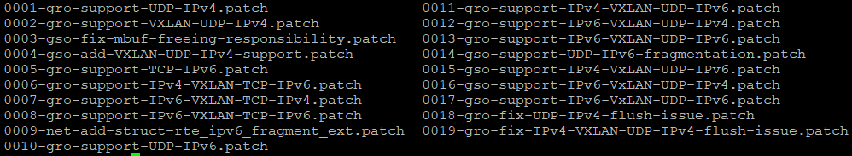
Implementation Details: DPDK
https://github.com/yyang13/ovsconf-2021/tree/master/dpdk-patches
GRO:
  UDP IPv4, UDP IPv4 in IPv4 VXLAN, TCP IPv6, TCP IPv6 in IPv4 VXLAN, TCP IPv4 in IPv6 VXLAN , TCP IPv6 in IPv6 VXLAN, UDP IPv6, UDP IPv4 in IPv6 VXLAN, UDP IPv6 in IPv4 VXLAN, UDP IPv4 in IPv6 VXLAN, UDP IPv6 in IPv6 VXLAN
GSO:
  UDP IPv4 in IPv4 VXLAN, UDP IPv6 in IPv4 VXLAN, UDP IPv6, UDP IPv6 in IPv6 VXLAN, UDP IPv4 in IPv6 VXLAN

Slide 19
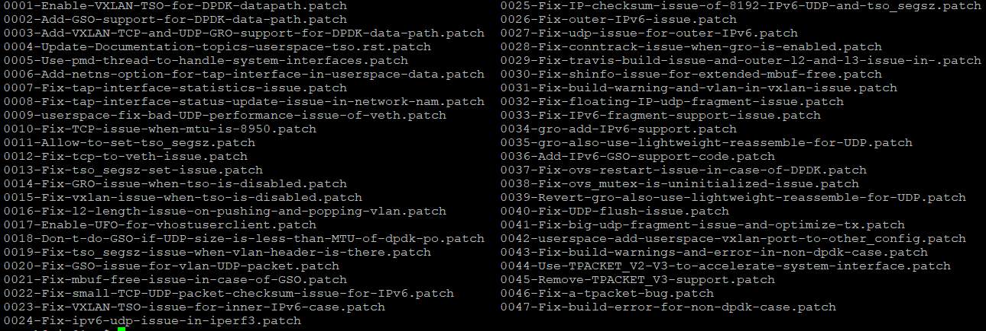
Implementation Details: OVS DPDK
https://github.com/yyang13/ovsconf-2021/tree/master/ovs-patches
Enable VXLAN TSO Add GRO support
Add GSO support Enable UFO
Use TPACKET_V2 for tap interface

Slide 20
Implementation Details: openstack
  os-ken
    https://review.opendev.org/c/openstack/os-ken/+/795963
    Enhance os-ken to support Nicira PacketIn2: transmit customized userdata to controller
  Neutron
    https://review.opendev.org/c/openstack/neutron/+/805930
    Use Openflow to implement DVR L3
    https://review.opendev.org/c/openstack/neutron/+/818338
    Set network namespace and tap interface type in case of OVS DPDK
  Nova
    https://review.opendev.org/c/openstack/nova/+/818337
    Support legacy tap interface for OVS DPDK
    Why to enable VM Use Tap? launch more VMs, uses more memory (far more than physical memory)
    How about performance?

Slide 21
Implementation Details: VM openflow pipeline
    https://review.opendev.org/c/openstack/neutron/+/805930
ACCEPTED_EGRESS_TRAFFIC_NORMAL_TABLE = 94
ARP Request
LOCAL_ARP_REPLY_TABLE = 100
routing
ACL_EGRESS_TABLE = 110
goto_table
PBR_ROUTING_TABLE = 120
goto_table
PBR routing
ACL_INGRESS_TABLE = 140
goto_table
GENERAL_ROUTING_TABLE = 130
goto_table
To br-ex
LOCAL_QROUTER_ARP_TABLE = 150
output
VNET_OUTPUT_TABLE = 151
To tunnel port
Reverse SNAT
To Local VM
SNAT_TABLE = 170
ACCEPT_OR_INGRESS_TABLE = 73

Slide 22
Implementation Details: FIP openflow pipeline
TRANSIENT_TABLE = 60
FIP traffic
FIP_INGRESS_TABLE = 160
goto_table
FIP_TO_VMIP_TABLE = 161
Learn MAC
LOCAL_FIP_ARP_TABLE = 162
CONTROLLER
LOCAL_SWITCHING = 0
From fg port
From VM with FIP
FIP_OUTPUT_TABLE = 163
LOCAL_QROUTER_ARP_TABLE = 150
src ip is fip
FIP_EGRESS_TABLE = 164
src/dst ip == fg ip
SNAT_TABLE = 170
FIP_FORK_TABLE = 165
New SNAT
SNAT_TMP_TABLE = 171
To external
To local FIP
    https://review.opendev.org/c/openstack/neutron/+/805930

Slide 23
Performance Comparison

Slide 24
Performance Comparison (TCP & UDP only for tap)

Slide 25
Performance Comparison (pps & packet loss rate, only for tap)

Slide 26
Future Work
Verify IPv6 (including IPv6 VxLAN) in OVS DPDK
Use Openflow to implement IPv6 support in Neutron
Centralized virtual network support (including centralized FIP, FIP port forwarding)
Remove code in ovs agent and l3 agent for netns
Push patches to merge my patches
Improve performance for NICs which don’t have VxLAN TSO feature

Slide 27
Demo
https://github.com/yyang13/ovsconf-2021/blob/master/demo-video.mp4

Slide 28
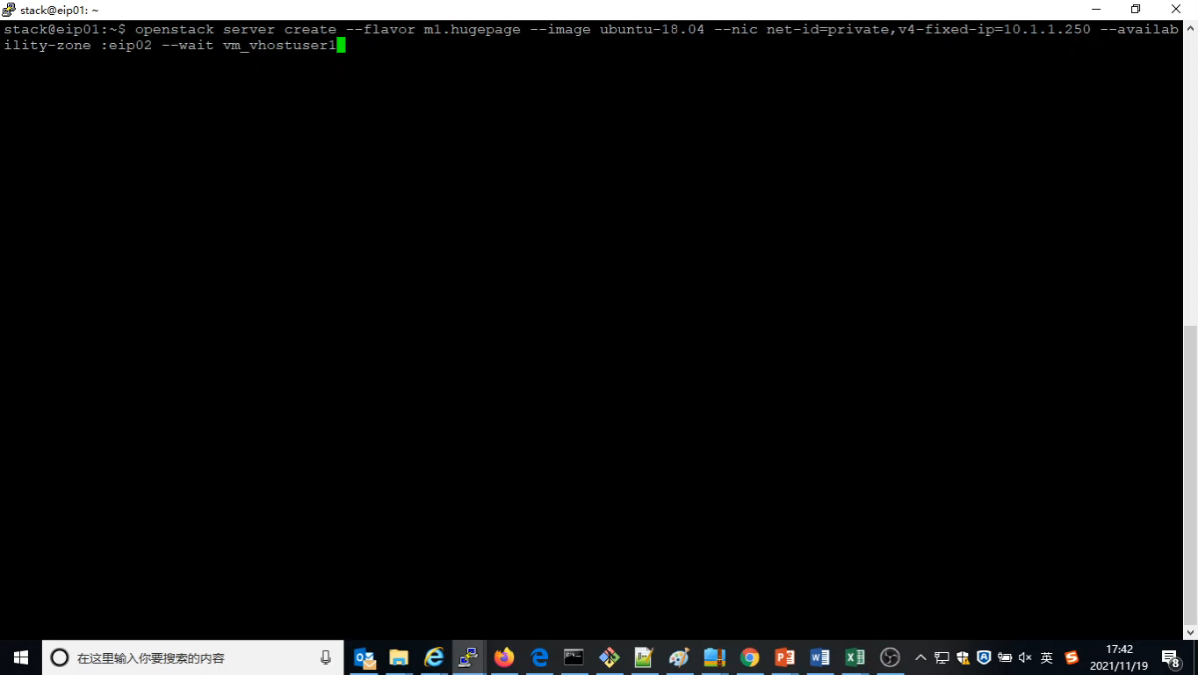

Slide 29

Thank you!!!

