Slide 1
OVS Conference 2020. OVS benchmark
Dec 2020
Guy Twig & Roni Bar Yanai
NVIDIA

Slide 2
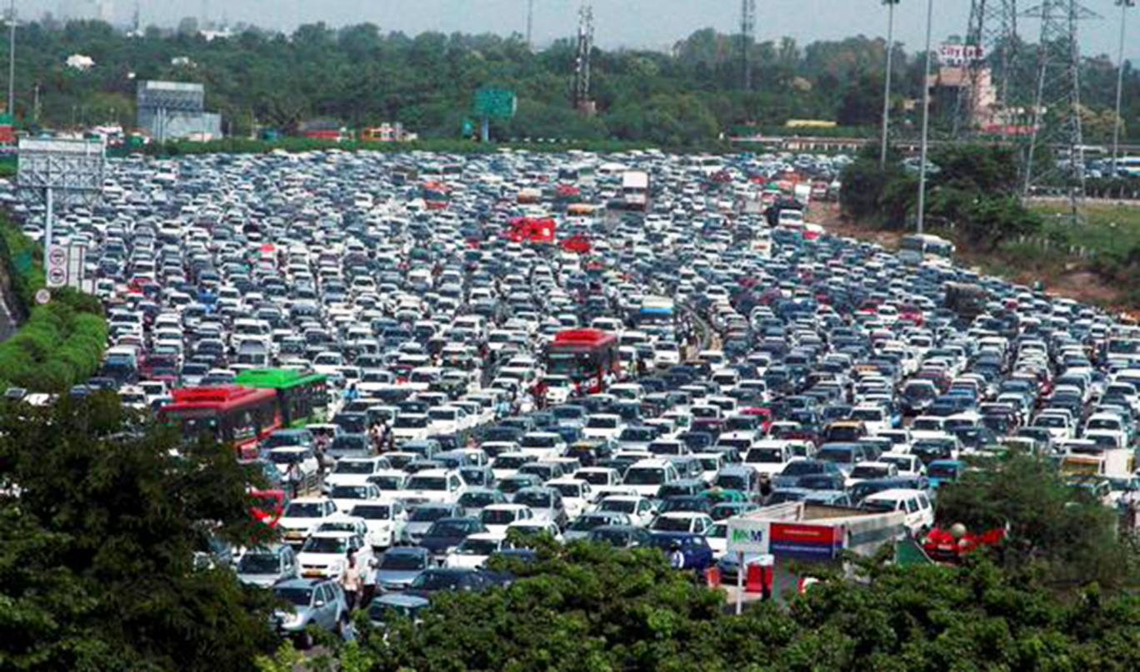

Agenda
Worst Case
Common switch benchmarks
Networking traffic pattern
Extending benchmark with common case
Results
Best Case

Slide 3
Common Switch Benchmarks

Slide 4

Switch Benchmarks
Common Practice
RFC 2544
Focus on worst case scenario
Worst Case:
  Fixed packet size 64,128,256,…
  Concurrency of “flows/sessions”, that depends on tested use case
  Round robin or random flow per packet
Internet MIX (IMIX)
  Choosing a mix of packet sizes
  Traffic is still random
  Current studies shows that typical traffic has average of 500 bytes to 800 bytes, with strong appearance on edges
RFC 8204
VSPERF

Slide 5
Benchmarks
If I can run in worst case, then I’m good for common right?
Compute resources
Not Necessarily:
  Different scenarios have different bottlenecks
  Having max rate on 64 bytes, will not stretch PCI for example
  Max MTU might stretch PCI, but not memory
  Processing time depends on packet size
  Mix if packet sizes can hurt PCI optimizations
100 Gbps require different testing of the infrastructure
  64 bytes packet on 100Gbps is > 148MPPS
  Typical SW switch can support 500kPPS (community) – 2MPPS (optimized) per core (DPDK)
  Host required to allocate 50-100 cores just for forwarding traffic (assuming scale is linear)
  Single session (elephant) can be blocked by core capacity
Packet delivery resources

Slide 6
Elephant Flow vs Mice Flow and flow locality

Slide 7
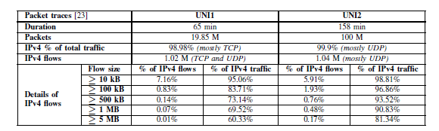
Elephant vs mice flows
Small percentage of the flows consume most of the bytes in the system
Public traces http://pages.cs.wisc.edu/~tbenson/IMC10_Data.html
Out of the million flows:
100 flows consumed 60% of the bytes
71k consumed 95% percent of the bytes
Observation: Optimizing only ~5% of the flows, can affect more than 90% of the total bytes

Slide 8
Elephant vs mice flows
Small percentage of the flows consume most of the bytes in the system
Another cited work: Network Traffic Characteristics of Data Centers in the Wild [1]
The authors have analyzed traces from 10 different data centers, having web services, file storage, line of business application, customer enterprise application and data intensive applications such as map-reduce.
Data centers we commercial, private enterprise and campus
Most of the flows are less than 10kbytes
10% of the flows consumed most of the data
Packet size is clustering around 200 bytes and 1440 bytes
New flow rate: 2%-20% of the flows opened with 10 micro interval
The number of active sessions within a time frame was much smaller than the overall concurrent flows
[1] BENSON, T., ANAND, A., AKELLA, A., AND ZHANG, M. Understanding Data Center Traffic Characteristics. In Proceedings of ACM WREN, 2009

Slide 9
Elephant vs mice flows
Elephant vs Flows haven't changed match
Analysis of TCP Flow Characteristics [2]
In this work, flow characteristics were analyzed 2009-2011 and 2015-2016
Number of flows is higher by ratio and behavior is the same
Long lived flows consumed 90%-95% of the bytes and that haven’t changed
Long flow duration became longer
Inside the Social Network’s (Datacenter) Network [3]
Social network was analyzed
70% of the flows were less than 10kbytes, and median flow size was less than 1kbytes
Looking on single msec, 15-30 flows consumed more than 50% of the bytes
On 5 msec time frame there were only 1000 active sessions
[2] X Cui, X Xu, Q ShenLi, X Liang - International Conference on Computer, Network, Communication and Information Systems (CNCI 2019)
[3] A. Roy, H. Zeng, J. Bagga, G. Porter, and A. C. Snoeren. Inside the social network's (datacenter) network. SIGCOMM'15, pages 123–137.

Slide 10
Elephant Flow vs mice flows
Strong Locality
TCP nature of sending a batch of packets on every acknowledgment generates bursts within the flows
Research have shown that on a small-time frame only fraction of the flows are in fact active
Locality also fits the elephant vs mice nature of traffic; big flows need throughput and for that TCP window size should be high. Big TCP window generates locality

Slide 11
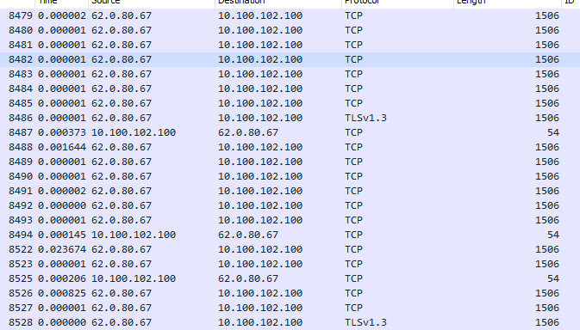


Locality in Video
8 packets within 10 micro received
8 packets within 9 micro received
Client ack, 400 micro
6 packets within 5 micro received
Traffic record were taken on client. It is assumed that on server locality is even stronger. RTT to server was less than 5msec

Slide 12
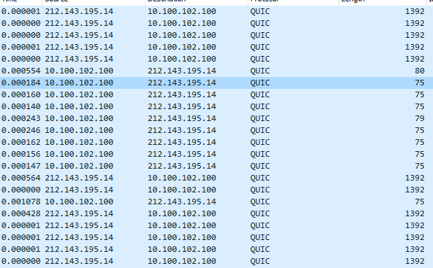

Locality in Video
5 packets within 3 micros
QUIC acknowledge packets
2 packets in less than a micro
5 packets in less than 3 micro
Youtube are using QUIC as transport layer. Shows similar behavior as TCP

Slide 13
Locality and caching
100Gbps
Looking on 10 microseconds time frame
Limited to 1950 packets of size 64 bytes
Locality:
Even small cache can assure that locality shown withing 10 microseconds is supported
Modern caches that can support thousands of concurrent flows will show benefit
Limited to 244 packets of 512 bytes
M=time slot in micro.
total-packets-msec = max_bps/8/ packet-size/((10^6)/M)

Slide 14
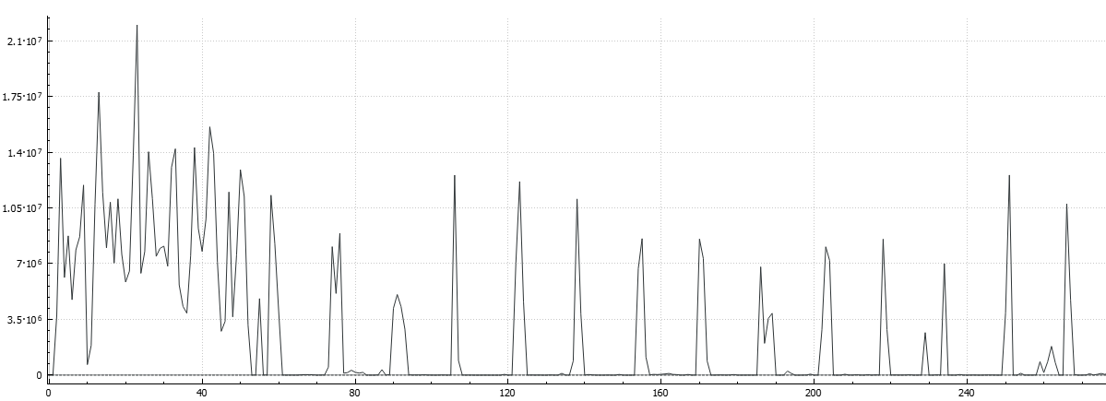
Active Flows Video
It is shown that the client flows are active only part of the time (in seconds)
Server might have 5-10 times concurrent “big” flows but only 10%-20% will be active on a specific second
Only fraction will be active on microsecond
Video traffic is active only 10%-20% of the time
Video is mostly ABR – Adaptive bit rate

Slide 15
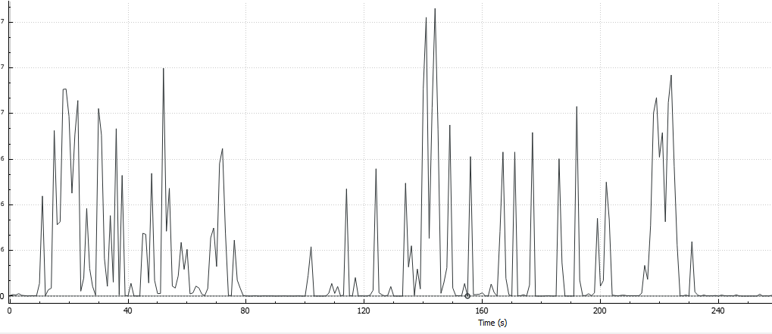


Active Flows social media
Recorded on client
Going over feed of Facebook
Shown strong locality
Like video (some content is video)
Video traffic is active only 10%-20% of the time

Slide 16
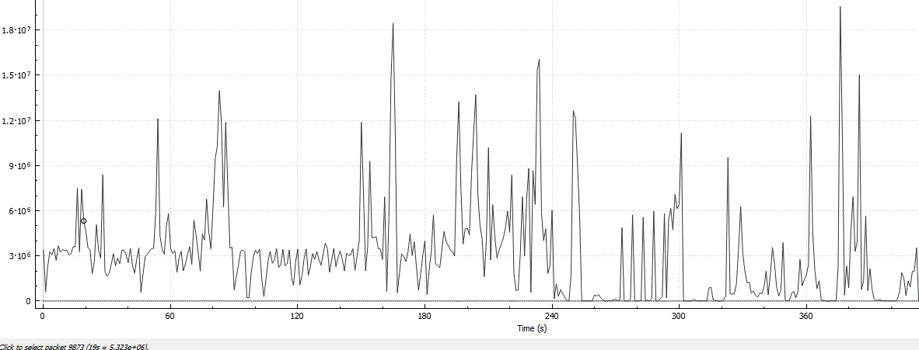

Active Flows Browsing
Less locality is shown both on active sessions and a bit less on TCP level
Still locality was high and shown 2-6 TCP packets withing 10 micro
10 biggest flows out of 1900 flows consumed 70% of the bytes

Slide 17
Conclusions
Typical traffic shows a strong locality on the microsecond level
Flows with strong locality are also the flows that consume most of the bytes
Only 10%-20% of the consuming flows are active on a second time frame
Most of the flows are very small and ends with less than 10kbytes

Slide 18
Common case Use Cases
Testing caching strategic, for example testing EMC vs. SMC
Testing HW offload benefit, where typically CPU is busy with small flows open rate and HW still handle the large flows
Offload and optimization strategic
Infrastructure planning

Slide 19
Testing
Notes:
Thanks Roni.
I’m Guy Twig from the SW performance team.
Now we are going to talk about our testing

Slide 20
Benchmark setup
Drivers
Kernel
VM
TREX
We use Trex due to its availability as SW traffic generator.
testpmd
NVIDIA BlueField-2 DPU
OVS-DPDK
100GbE
Port 1
Port 1
Port 2
Port 2
Packet Generator
RAM
CPU
Notes:
The topology we choose to use in the benchmark is as the following:
The DUT is BlueField-2 DPU connected B2B to another host with TREX installed as SW traffic generator
On The ARM, OVS-DPDK with HW offload and configured with VxLAN and connection tracking rules/
On the VM side we are using testpmd as a forwarder.
For OVS-DPDK we are using in 4 cores
The setup is performance tuned

Slide 21
Traffic stream
Elephant Stream
pkt1 | … | pkt1 | pkt2 | … | pkt2 | … | pktN
Stream Calculation Example:
M
Stream Type | Locality | Flows | Packet Size (B) | Total Bytes
Elephant stream | 8 | 1,000 | 1400 | 11200
8 * Mice stream | 1 | 100,000 | 64 | 512
6 * Mice stream | 1 | 100,000 | 128 | 768
6 * Mice stream | 1 | 100,000 | 256 | 1536
N – how many different packets in stream
M – Locality number – how many same packets in a row
N*M – Total number of packets in Elephant Stream
The size of each packet in elephant stream is 1400B
Total stream sequence size = 11200 + 8*64 + 6*128 + 6*256 = 14016B
Total stream sequence = 8 + 1*8 + 1*6 + 1*6 = 28 pkts
Average packet size = 14016/28 = 500B
Theoretic MPPS for 100Gb/s = 100*10^9/((500+20)*8) = 24.01 MPPS
Elephant Stream has 80% Bytes from all the stream
Mice Stream
pkt1 | pkt2 | … | pktn
N
N – how many different packets in stream between row packets
The size of each packet in mice stream is 64B/128B/256B
Notes:
As Roni mentioned we separated the stream for two streams, elephant stream and mice stream.
The main idea is that the elephant stream holds something like 1K flows with 1400B packet size. The stream doesn’t have much packets, but in overall it holds from 70-80% of the total Bytes stream
Also it holds a locality number that represent the number of packets that will be in a row (for better caching).
The Mice stream has many packets but overall holds only up to 30% of total Bytes.
Each mice stream has many different packets with 128B or 256B packet size.
For the testing we used 1 Elephant stream with 1440B and 1K flows, 5 mice streams with 128B and 5 mice stream with 256B. Each mice stream has 30K different packets

Slide 22
Locality vs. worst case
Tested Stream
Elephant Stream: N=1K ;M=10
Mice Stream: N=10
1 Elephant stream with 1K flows and locality 10. – packet size 1440B
5 * mice streams with 30K flows – packet size 128B
5 * mice streams with 30K flows – packet size 256B
Notes:
ES_pkt1*10-MS1_128_pkt1-MS1_256_pkt1-MS2_128_pkt1-MS2_256_pkt1…ES_pkt2*10-MS1_128_pkt2-MS1_256_pkt2-MS2_128_pkt2-MS2_256_pkt2…

Slide 23
HW offload vs SW VirtIO
Tested Stream
Elephant Stream: N=1K ;M=10
Mice Stream: N=10
1 Elephant stream with 1K flows and locality 10. – packet size 1440B
5 * mice streams with 30K flows – packet size 128B
5 * mice streams with 30K flows – packet size 256B
SW VirtIO tested with 4 cores and over ConnectX-6 Dx

Slide 24
Summary
We could only achieve dozens of microseconds inter gap and not microseconds as defined
Still showed that small locality of 4-8 packets of less than 30% of the overall packets had 7%-10% impact in PPS and throughput
We think that once we can generate better locality we can reach line rate in such scenario
Setting a more realistic scenario can focus in creating the right optimizations
Having real case scenario can show the real saving in cores when using HW offload
In the future we plan to combine such test with open-rate creating full realistic scenario
  long elephant flows opening and closing
  mice flows opening and closing

