Slide 1
Ciara Loftus
Intel
Benchmarking & Comparing Open vSwitch using VSPERF

Slide 2
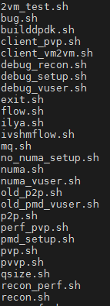
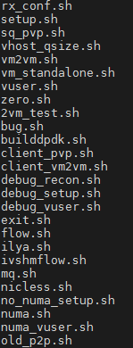
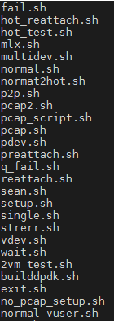
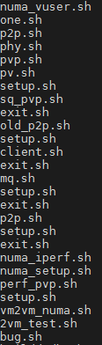
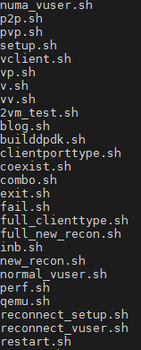
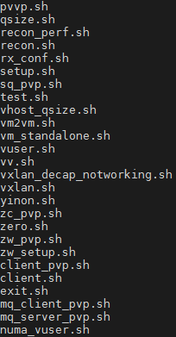
My SHameful Past

Slide 3

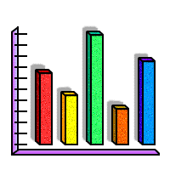



VSPERF
VS
PERF
vSwitch
Performance
VSPERF

Slide 4
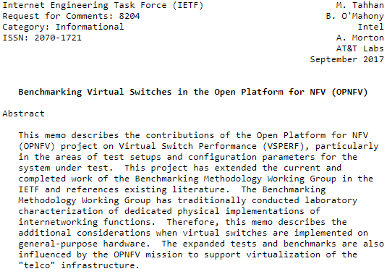
IETF RFC 8204
RFC
8204

Slide 5




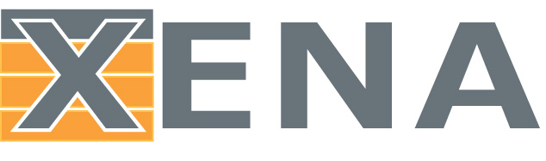


Within VSPERF
vSwitches
Traffic Generators
VNFs
DPDK TestPMD
Linux bridge
PCI Passthrough
MoonGen
+ many more!

Slide 6

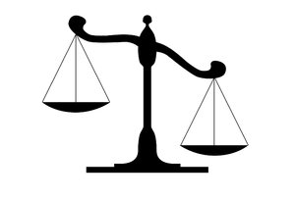

Types of VSPERF Tests
Performance
Functional
Comparative
Different tests appeal to different users

Slide 7

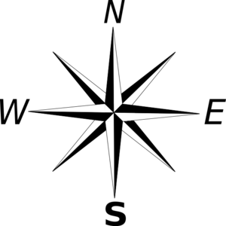
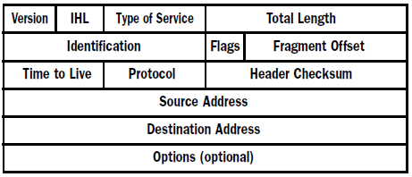
VSPERF Performance Tests
Throughput & latency testing via RFC2544
Performance
Customisable topologies
Configurable test parameters

Slide 8
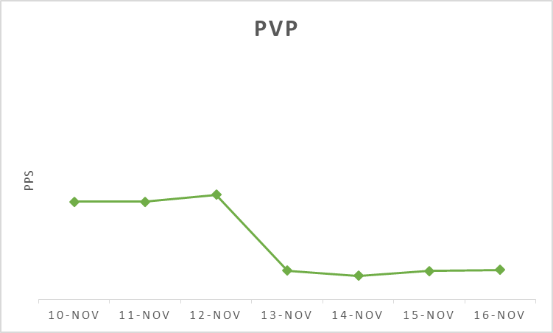
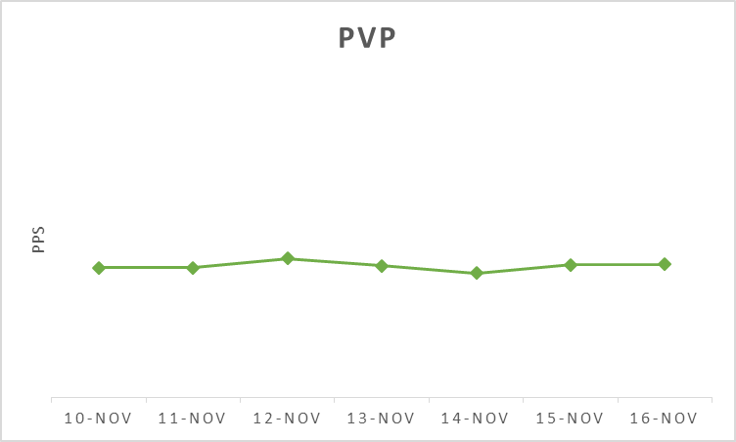
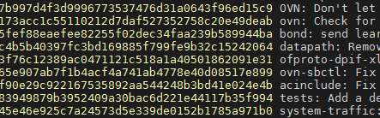
Using Performance Tests in CI

Slide 9
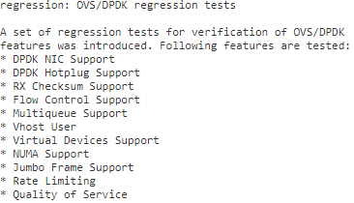
VSPERF Functional Testing
New OVS DPDK regression tests*
Time saving
Easy to add new tests
Functional
* https://gerrit.opnfv.org/gerrit/#/c/46519/

Slide 10
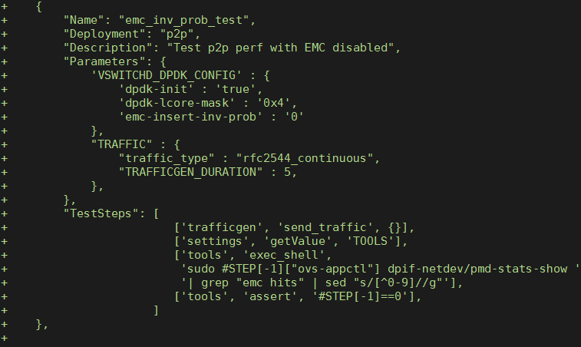
“Demo”: Creating a new feature test
EMC Insert Probability Test
Disable EMC
Send traffic
Measure performance (pps)
Make sure EMC was not hit

Slide 11

VSPERF Comparative Benchmarking
Multiple vSwitch implementations supported:
Execute tests & compare
Comparative
+

Slide 12
Evaluation vSwitches using VSPERF
Cloud Use Case
Telco Use Case

Slide 13

Considerations when Comparing vSwitches

Slide 14
Takeaways
Test Variety
Time Saving
Open Source
Multiple
vSwitches
Developer-friendly
vSwitch comparison
VNFs
Multiple Traffic Gens
Repeatable
Easy to add func tests
RFC8204
Customisable

Slide 15
Questions?

Slide 16
Backup

Slide 17

Notices & Disclaimers
Intel technologies’ features and benefits depend on system configuration and may require enabled hardware, software or service activation. Performance varies depending on system configuration. Check with your system manufacturer or retailer or learn more at intel.com.
No computer system can be absolutely secure.
Tests document performance of components on a particular test, in specific systems. Differences in hardware, software, or configuration will affect actual performance. Consult other sources of information to evaluate performance as you consider your purchase. For more complete information about performance and benchmark results, visit http://www.intel.com/benchmarks .
Software and workloads used in performance tests may have been optimized for performance only on Intel microprocessors. Performance tests, such as SYSmark and MobileMark, are measured using specific computer systems, components, software, operations and functions. Any change to any of those factors may cause the results to vary. You should consult other information and performance tests to assist you in fully evaluating your contemplated purchases, including the performance of that product when combined with other products. For more complete information visit http://www.intel.com/benchmarks .
Intel's compilers may or may not optimize to the same degree for non-Intel microprocessors for optimizations that are not unique to Intel microprocessors. These optimizations include SSE2, SSE3, and SSSE3 instruction sets and other optimizations. Intel does not guarantee the availability, functionality, or effectiveness of any optimization on microprocessors not manufactured by Intel. Microprocessor-dependent optimizations in this product are intended for use with Intel microprocessors. Certain optimizations not specific to Intel microarchitecture are reserved for Intel microprocessors. Please refer to the applicable product User and Reference Guides for more information regarding the specific instruction sets covered by this notice.
Cost reduction scenarios described are intended as examples of how a given Intel-based product, in the specified circumstances and configurations, may affect future costs and provide cost savings. Circumstances will vary. Intel does not guarantee any costs or cost reduction.
Intel does not control or audit third-party benchmark data or the web sites referenced in this document. You should visit the referenced web site and confirm whether referenced data are accurate.
© 2017 Intel Corporation.
Intel, the Intel logo, and Intel Xeon are trademarks of Intel Corporation in the U.S. and/or other countries.
*Other names and brands may be claimed as property of others.

