Slide 1
OpenVSwitch conference Nov/2015
Tony van der Peet, Christchurch, NZ

Slide 2
Contents
Introduce myself briefly
Our OpenFlow projects
Future directions
  TTPs
  OF-DPA
slide 2

Slide 3
Introduction
MSc in Astrophysics, VUW, 1987
Career in networking started Dec/1988, in DSIR, New Zealand
Continuous chain of ownership:
  DSIR ⇨ IRL ⇨ Network Dynamics ⇨ Securicor 3Net ⇨ Teltrend
  Allied Telesis KK (since ~2000)
Personally, I had time out in Telecom NZ, Sep/2007 – Feb/2012
Arrived back „home“ just in time for ...
slide 3

Slide 4

OpenFlow
slide 4

Slide 5
High-level timeline
May/2012 – First mention of OpenFlow in my work diary
Aug/2012 – Position paper on OpenFlow for internal distribution
Oct/2012 – Start prototype project, including first use of OpenVSwitch
Apr/2013 – Serious work on prototype begins (1 person)
May/2013 – First flow in silicon
Jul/2013 – Change to dpif model, OVS 1.10.0
Aug/2013 – OVS master
Sep/2013 – First OpenFlow demonstration to company meeting
Nov/2013-Feb/2014 – Summer project to consolidate the work
slide 5

Slide 6
High-level timeline
Dec/2013 – First look at OF-DPA
Jul/2014 – Another look at OF-DPA
Oct/2014 – Plugfest in Wellington, NZ
Nov/2014 – ONF plugfest, Roseville, CA
Feb/2015-today – New OpenFlow project team in San Jose office
slide 6

Slide 7
Using OpenVSwitch
Doesn’t get that much mention above, because it just works
Moving to the tip of master was a great move
Bugs are almost invariably introduced by us!
Features that are beneficial include no warnings, consistent format, good code structure, great support, high levels of activity (thank you!)
slide 7

Slide 8
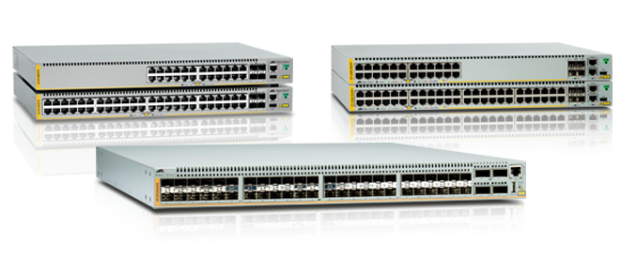
Particular features
OpenVSwitch does software switching, we have hardware switches
Silicon limitations
  VLAN tagging
  Missing matches and actions
Limited (dpif) flow table size – opportunity to add value
Variety of silicon – need to be careful with this
CPUs can have limited performance – another challenge
However, amount of our code is surprisingly small (at least with dpif)
slide 8

Slide 9
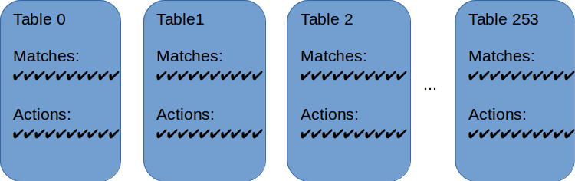
Future directions - TTP
OpenVSwitch supports all tables, matches and actions
This is very powerful and flexible, but…
slide 9

Slide 10
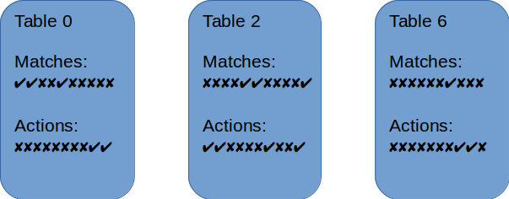
Future directions - TTP
… a given application will use a subset of tables
… and have different matches and actions in each one
slide 10

Slide 11
Future directions - TTP
The TTP (Table Type Pattern) is a formal description of flow table structure
Some of the latest thinking from Curt Beckmann, at recent MWD
App W
App X
App Y
App Z
Fully abstracted NBI
Mapping layer
Use Case TTPs very similar to Flow Objectives
TTP A
Use Case Rules
TTP B
Use Case Rules
TTP C
Use Case Rules
Mapping layer
Model Driven abstraction layers build the southbound mappings “automagically”… use flowpaths
TTP R Device Features
TTP S Device Features
TTP T Device Features
Device Q
Device R
Device S
Device T
TTP A
Agent
TTP B
Agent
TTP R
Agent
TTP S
Agent
TTP T
Agent
slide 11
Device supports only one vendor-centric model

Slide 12
Future directions - TTP
There have been examples of both uses of TTP created already (ONF site)
  Project Atrium has defined an application centric TTP
  This is relatively short and concise
  An example of a switch centric TTP comes from OF-DPA
slide 12

Slide 13
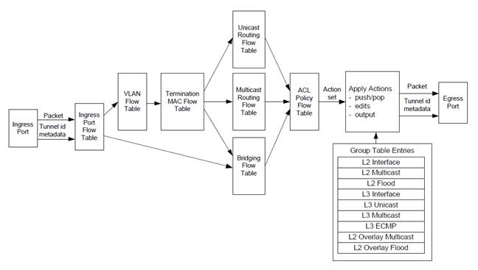
Future directions - OF-DPA
slide 13

Slide 14
Future directions - OF-DPA
The OF-DPA pipeline
Both silicon and OpenFlow use the same pipeline
A TTP has been created
Full utilisation of switch resources, wire-speed forwarding
slide 14

Slide 15
Suggested changes to OpenVSwitch
Support for TTPs
  Optional for ofproto-dpif, via database parameter
  Affects table features response if present
  Affects ofproto’s rule processing if present
  TTPs have been published as json documents, json support exists already
Support for a new ofproto, ofproto-ttp
  TTP will be mandatory
  Sub-layer called ttp, which may implement the TTP
  Or use the generic code described above
  Rule processing can then implement hardware mappings for the TTP
  Sub-layer will also have to implement functionality found in the dpif layer
slide 15

Slide 16
Suggested changes to OpenVSwitch
I have started doing this work, and will implement as much as I need to to allow us to implement OF-DPA
Would like some level of support from the OVS community
In order of preference:
  Advice on my implementation ideas
  Support in the upstream project (so we aren’t carrying this code forever)
  Help with implementation!
Not expecting huge enthusiasm for this work
  Limitation to OVS, rather than an enhancement
  OVS is a software switch, we are driven by hardware considerations
But I am prepared to be pleasantly surprised
And would love the chance to discuss my plans with the experts
slide 16

Slide 17

Thank you
Americas Headquarters | 19800 North Creek Parkway | Suite 100 | Bothell | WA 98011 | USA | T: +1 800 424 4284 | F: +1 425 481 3895
Asia-Pacific Headquarters | 11 Tai Seng Link | Singapore | 534182 | T: +65 6383 3832 | F: +65 6383 3830
EMEA Headquarters | Via Motta 24 | 6830 Chiasso | Switzerland | T: +41 91 69769.00 | F: +41 91 69769.11
© 2011 Allied Telesis Inc. All rights reserved. Information in this document is subject to change without notice. All company names, logos, and product designs that are trademarks or registered trademarks are the property of their respective owners.

