Slide 1
Fast Userspace OVS with AF_XDP
OVS Conference 2018
William Tu, VMware Inc

Slide 2
Outline
AF_XDP Introduction
OVS AF_XDP netdev
Performance Optimizations

Slide 3
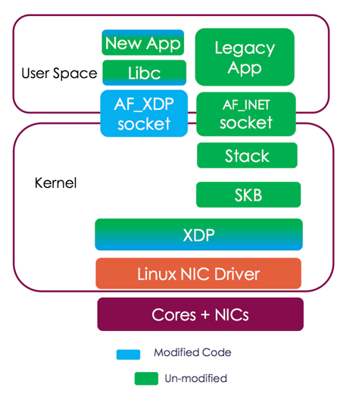
Linux AF_XDP
A new socket type that receives/sends raw frames with high speed
Use XDP (eXpress Data Path) program to trigger receive
Userspace program manages Rx/Tx ring and Fill/Completion ring.
Zero Copy from DMA buffer to user space memory with driver support
Ingress/egress performance > 20Mpps [1]
From “DPDK PMD for AF_XDP”, Zhang Qi
[1] The Path to DPDK Speeds for AF XDP, Linux Plumber 2018

Slide 4

OVS-AF_XDP Netdev
ovs-vswitchd
User space
Userspace Datapath
Goal
Use AF_XDP socket as a fast channel to usersapce OVS datapath, dpif-netdev
Flow processing happens in userspace
AF_XDP
socket
Network Stacks
Kernel
high speed channel
Driver + XDP
Hardware
Notes:
Previous approach introducing BPF_ACTION
Tc is a Kernel packet queuing subsystem, provide QoS ….
Ovs-vswitch creates map, load ebpf programs, etc

Slide 5
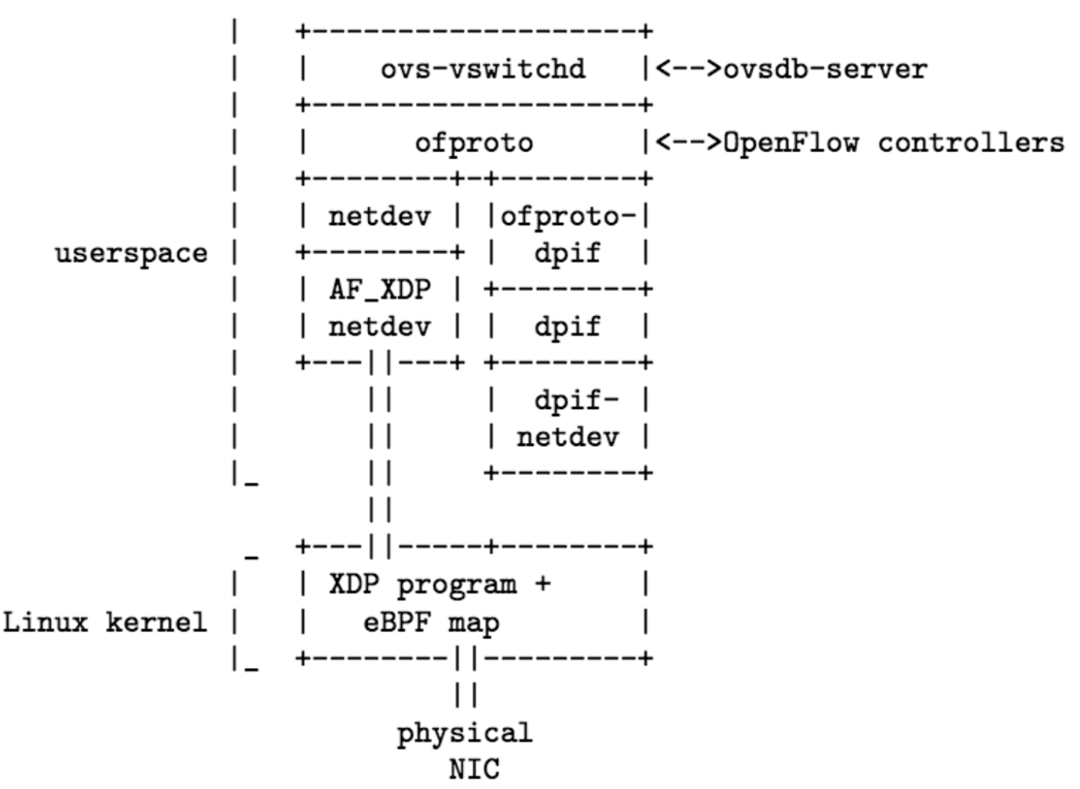
OVS-AF_XDP Architecture
Existing
netdev: abstraction layer for network device
dpif: datapath interface
dpif-netdev: userspace implementation of OVS datapath
New
Kernel: XDP program and eBPF map
AF_XDP netdev: implementation of afxdp device
ovs/Documentation/topics/porting.rst

Slide 6
OVS AF_XDP Configuration
#./configure
# make && mask install
# make check-afxdp
# ovs-vsctl add-br br0 -- \
set Bridge br0 datapath_type=netdev
# ovs-vsctl add-port br0 eth0 -- \
set int enp2s0 type="afxdp”
Based on v3 patch: [ovs-dev] [PATCHv3 RFC 0/3] AF_XDP netdev support for OVS

Slide 7

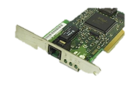
Prototype Evaluation
20Mpps
br0
sender
16-core Intel Xeon
E5 2620 v3 2.4GHz
32GB memory
DPDK packet generator
enp2s0
Netronome
NFP-4000
Intel XL710
40GbE
+ AF_XDP
Userspace Datapath
ingress
Egress
Sender sends 64Byte, 20Mpps to one port, measure the receiving packet rate at the other port
Measure single flow, single core performance with Linux kernel 4.19-rc3 and OVS master
Enable AF_XDP Zero Copy mode
Performance goal: 20Mpps rxdop
Notes:
Compare Linux kernel 4.9-rc3

Slide 8
Time Budget
Budget your
packet like
Budget your
money
To achieve 20Mpps
Budget per packet: 50ns
2.4GHz CPU: 120 cycles per packet
Fact [1]
Cache misses: 32ns, x86 LOCK prefix: 8.25ns
System call with/wo SELinux auditing: 75ns / 42ns
Batch of 32 packets
Budget per batch: 50ns x 32 = 1.5us
[1] Improving Linux networking performance, LWN, https://lwn.net/Articles/629155/, Jesper Brouer

Slide 9
Optimization 1/5
OVS pmd (Poll-Mode Driver) netdev for rx/tx
  Before: call poll() syscall and wait for new I/O
  After: dedicated thread to busy polling the Rx ring
Effect: avoid system call overhead
+const struct netdev_class netdev_afxdp_class = {
+ NETDEV_LINUX_CLASS_COMMON,
+ .type = "afxdp",
+ .is_pmd = true,
.construct = netdev_linux_construct,
.get_stats = netdev_internal_get_stats,

Slide 10
Optimization 2/5
Packet metadata in continuous memory region
(struct dp_packet)
Packet metadata pre-allocation
  Before: allocate md when receives packets
  After: pre-allocate md and initialize it
Effect:
  Reduce number of per-packet operations
  Reduce cache misses
One-to-one maps to AF_XDP umem
Multiple 2KB umem chunk memory region
storing packet data

Slide 11
Optimizations 3-5
Packet data memory pool for AF_XDP
  Fast data structure to GET and PUT free memory chunk
  Effect: Reduce cache misses
Dedicated packet data pool per-device queue
  Effect: Consume more memory but avoid mutex lock
Batching sendmsg system call
  Effect: Reduce system call rate
Reference: Bringing the Power of eBPF to Open vSwitch, Linux Plumber 2018

Slide 12
Performance Evaluation

Slide 13
OVS AF_XDP RX drop
OVS AF_XDP
br0
DROP
enp2s0
# ovs-ofctl add-flow br0 \
"in_port=enp2s0, actions=drop"
# ovs-appctl pmd-stats-show

Slide 14
pmd-stats-show (rxdrop)
pmd thread numa_id 0 core_id 11:
packets received: 2069687732
packet recirculations: 0
avg. datapath passes per packet: 1.00
emc hits: 2069687636
smc hits: 0
megaflow hits: 95
avg. subtable lookups per megaflow hit: 1.00
miss with success upcall: 1
miss with failed upcall: 0
avg. packets per output batch: 0.00
idle cycles: 4196235931 (1.60%)
processing cycles: 258609877383 (98.40%)
avg cycles per packet: 126.98 (262806113314/2069687732)
avg processing cycles per packet: 124.95 (258609877383/2069687732)
120ns budget
for 20Mpps

Slide 15
Perf record -p `pidof ovs-vswitchd` sleep 10
26.91% pmd7 ovs-vswitchd [.] netdev_linux_rxq_xsk
26.38% pmd7 ovs-vswitchd [.] dp_netdev_input__
24.65% pmd7 ovs-vswitchd [.] miniflow_extract
6.87% pmd7 libc-2.23.so [.] __memcmp_sse4_1
3.27% pmd7 ovs-vswitchd [.] umem_elem_push
3.06% pmd7 ovs-vswitchd [.] odp_execute_actions
2.03% pmd7 ovs-vswitchd [.] umem_elem_pop
Mempool
overhead
top
PID USER PR NI VIRT RES SHR S %CPU %MEM TIME+ COMMAND
16 root 20 0 0 0 0 R 100.0 0.0 75:16.85 ksoftirqd/1
21088 root 20 0 451400 52656 4968 S 100.0 0.2 6:58.70 ovs-vswitchd

Slide 16
OVS AF_XDP l2fwd
OVS AF_XDP
br0
enp2s0
# ovs-ofctl add-flow br0 "in_port=enp2s0 actions=\
set_field:14->in_port,\
set_field:a0:36:9f:33:b1:40->dl_src, enp2s0"
Notes:
ovs-ofctl add-flow br0 "in_port=enp2s0\ actions=set_field:14->in_port,set_field:a0:36:9f:33:b1:40->dl_src,enp2s0"

Slide 17
pmd-stats-show (l2fwd)
pmd thread numa_id 0 core_id 11:
packets received: 868900288
packet recirculations: 0
avg. datapath passes per packet: 1.00
emc hits: 868900164
smc hits: 0
megaflow hits: 122
avg. subtable lookups per megaflow hit: 1.00
miss with success upcall: 2
miss with failed upcall: 0
avg. packets per output batch: 30.57
idle cycles: 3344425951 (2.09%)
processing cycles: 157004675952 (97.91%)
avg cycles per packet: 184.54 (160349101903/868900288)
avg processing cycles per packet: 180.69 (157004675952/868900288)
Extra ~55 cycles for send

Slide 18
Perf record -p `pidof ovs-vswitchd` sleep 10
25.92% pmd7 ovs-vswitchd [.] netdev_linux_rxq_xsk
17.75% pmd7 ovs-vswitchd [.] dp_netdev_input__
16.55% pmd7 ovs-vswitchd [.] netdev_linux_send
16.10% pmd7 ovs-vswitchd [.] miniflow_extract
4.78% pmd7 libc-2.23.so [.] __memcmp_sse4_1
3.67% pmd7 ovs-vswitchd [.] dp_execute_cb
2.86% pmd7 ovs-vswitchd [.] __umem_elem_push
2.46% pmd7 ovs-vswitchd [.] __umem_elem_pop
1.96% pmd7 ovs-vswitchd [.] non_atomic_ullong_add
1.69% pmd7 ovs-vswitchd [.] dp_netdev_pmd_flush
_output_on_port
Mempool
overhead
TOP results are similar to rxdrop

Slide 19
AF_XDP PVP Performance
VM
XDP redirect
QEMU 3.0.0
VM Ubuntu 18.04
DPDK stable 17.11.4
OVS-DPDK vhostuserclient port
  options:dq-zero-copy=true
  options:n_txq_desc=128
virtio
QEMU + vhost-user
OVS AF_XDP
br0
enp2s0
# ./configure --with-dpdk=
# ovs-ofctl add-flow br0 "in_port=enp2s0, \
actions=output:vhost-user-1"
# ovs-ofctl add-flow br0 "in_port=vhost-user-1,\
actions=output:enp2s0"
Notes:
10455 2018-12-04T17:34:15.952Z|00146|dpdk|INFO|VHOST_CONFIG: dequeue zero copy is enabled

Slide 20
PVP CPU utilization
PID USER PR NI VIRT RES SHR S %CPU %MEM TIME+ COMMAND
16 root 20 0 0 0 0 R 100.0 0.0 88:26.26 ksoftirqd/1
21510 root 20 0 9807168 53724 5668 S 100.0 0.2 5:58.38 ovs-vswitchd
21662 root 20 0 4894752 30576 12252 S 100.0 0.1 5:21.78 qemu-system-x86
21878 root 20 0 41940 3832 3096 R 6.2 0.0 0:00.01 top

Slide 21
pmd-stats-show (PVP)
pmd thread numa_id 0 core_id 11:
packets received: 205680121
packet recirculations: 0
avg. datapath passes per packet: 1.00
emc hits: 205680121
smc hits: 0
megaflow hits: 0
avg. subtable lookups per megaflow hit: 0.00
miss with success upcall: 0
miss with failed upcall: 0
avg. packets per output batch: 31.01
idle cycles: 0 (0.00%)
processing cycles: 74238999024 (100.00%)
avg cycles per packet: 360.94 (74238999024/205680121)
avg processing cycles per packet: 360.94 (74238999024/205680121)

Slide 22
AF_XDP PVP Performance Evaluation
./perf record -p `pidof ovs-vswitchd` sleep 10
15.88% pmd28 ovs-vswitchd [.] rte_vhost_dequeue_burst
14.51% pmd28 ovs-vswitchd [.] rte_vhost_enqueue_burst
10.41% pmd28 ovs-vswitchd [.] dp_netdev_input__
8.31% pmd28 ovs-vswitchd [.] miniflow_extract
7.65% pmd28 ovs-vswitchd [.] netdev_linux_rxq_xsk
5.59% pmd28 ovs-vswitchd [.] netdev_linux_send
4.20% pmd28 ovs-vswitchd [.] dpdk_do_tx_copy
3.96% pmd28 libc-2.23.so [.] __memcmp_sse4_1
3.94% pmd28 libc-2.23.so [.] __memcpy_avx_unaligned
2.45% pmd28 ovs-vswitchd [.] free_dpdk_buf
2.43% pmd28 ovs-vswitchd [.] __netdev_dpdk_vhost_send
2.14% pmd28 ovs-vswitchd [.] miniflow_hash_5tuple
1.89% pmd28 ovs-vswitchd [.] dp_execute_cb
1.82% pmd28 ovs-vswitchd [.] netdev_dpdk_vhost_rxq_recv
Notes:
16 root 20 0 0 0 0 R 100.0 0.0 10:17.12 ksoftirqd/1
19525 root 20 0 9807164 54104 5800 S 106.7 0.2 2:07.59 ovs-vswitchd
19627 root 20 0 4886528 30336 12260 S 106.7 0.1 0:59.59 qemu-system-x86

Slide 23
Performance Result
OVS AF_XDP | PPS | CPU
RX Drop | 19Mpps | 200%
L2fwd [2] | 14Mpps | 200%
PVP [3] | 3.3Mpps | 300%
OVS DPDK [1] | PPS | CPU
RX Drop | NA | NA
l3fwd | 13Mpps | 100%
PVP | 7.4Mpps | 200%
[1] Intel® Open Network Platform Release 2.1 Performance Test Report
[2] Demo rxdrop/l2fwd: https://www.youtube.com/watch?v=VGMmCZ6vA0s
[3] Demo PVP: https://www.youtube.com/watch?v=WevLbHf32UY

Slide 24
Conclusion 1/2
AF_XDP is a high-speed Linux socket type
We add a new netdev type based on AF_XDP
Re-use the userspace datapath used by OVS-DPDK
Performance
Pre-allocate and pre-init as much as possible
Batching does not reduce # of per-packet operations
Batching + cache-aware data structure amortizes the cache misses

Slide 25
Conclusion 2/2
Need high packet rate but can’t deploy DPDK? Use AF_XDP!
Still slower than OVS-DPDK [1], more optimizations are coming [2]
Comparison with OVS-DPDK
Better integration with Linux kernel and management tool
Selectively use kernel’s feature, no re-injection needed
Do not require dedicated device or CPU
[1] The eXpress Data Path: Fast Programmable Packet Processing in the Operating System Kernel
[2] The Path to DPDK Speeds for AF XDP, Linux Plumber 2018

Slide 26
Thank you

Slide 27
./perf kvm stat record -p 21662 sleep 10
Analyze events for all VMs, all VCPUs:
VM-EXIT Samples Samples% Time% Min Time Max Time Avg time
HLT 298071 95.56% 99.91% 0.43us 511955.09us 32.95us ( +- 19.18% )
EPT_MISCONFIG 10366 3.32% 0.05% 0.39us 12.35us 0.47us ( +- 0.71% )
EXTERNAL_INTERRUPT 2462 0.79% 0.01% 0.33us 21.20us 0.50us ( +- 3.21% )
MSR_WRITE 761 0.24% 0.01% 0.40us 12.74us 1.19us ( +- 3.51% )
IO_INSTRUCTION 185 0.06% 0.02% 1.98us 35.96us 8.30us ( +- 4.97% )
PREEMPTION_TIMER 62 0.02% 0.00% 0.52us 2.77us 1.04us ( +- 4.34% )
MSR_READ 19 0.01% 0.00% 0.79us 2.49us 1.37us ( +- 8.71% )
EXCEPTION_NMI 1 0.00% 0.00% 0.58us 0.58us 0.58us ( +- 0.00% )
Total Samples:311927, Total events handled time:9831483.62us.

Slide 28
root@ovs-afxdp:~/ovs# ovs-vsctl show
2ade349f-2bce-4118-b633-dce5ac51d994
Bridge "br0"
Port "br0"
Interface "br0"
type: internal
Port "vhost-user-1"
Interface "vhost-user-1"
type: dpdkvhostuser
Port "enp2s0"
Interface "enp2s0"
type: afxdp

Slide 29
QEMU
qemu-system-x86_64 -hda ubuntu1810.qcow \
-m 4096 \
-cpu host,+x2apic -enable-kvm \
-chardev socket,id=char1,path=/tmp/vhost,server \
-netdev type=vhost-user,id=mynet1,chardev=char1,vhostforce,queues=4 \
-device virtio-net-pci,mac=00:00:00:00:00:01,netdev=mynet1,\
mq=on,vectors=10,mrg_rxbuf=on,rx_queue_size=1024 \
-object memory-backend-file,id=mem,size=4096M,mem-path=/dev/hugepages,share=on \
-numa node,memdev=mem -mem-prealloc -smp 2

